Slide 1








FP7 ERA-Net project (no. 249667)
  VineMan.org
  Integration of plant resistance, cropping practices, and biological control agents for enhancing disease management, yield efficiency, and biodiversity in organic European vineyards

Slide 2
  The Consortium
  Università Cattolica del Sacro Cuore (UCSC) – Italy
  Agricultural Research Council (CRA-VIC) – Italy
  AGES - Institute of Plant Health (IPGH) – Austria
  Staatliches Weinbauinstitut (SWI) – Germany
  Universidad de La Rioja (UDLR) – Spain
  Agricultural Institute of Slovenia (KIS) – Slovenia
  Education and research centre for enology and pomology (LFZ) – Austria
  University of Natural Resources and Life Sciences (BOKU) – Austria

Slide 3
Aim
develop innovative cropping systems for managing organic vineyards
able to:
  improve control of key plant diseases
  enhance grape production
  reduce mycotoxin contamination
  increase microbial biodiversity
  minimize the environmental impact
Design
How
through a
design-assessment-adjustment cycle
Evaluate
Develop
Test

Slide 4
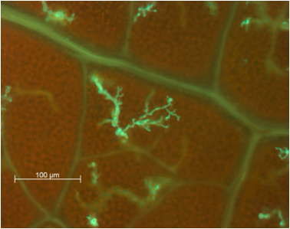
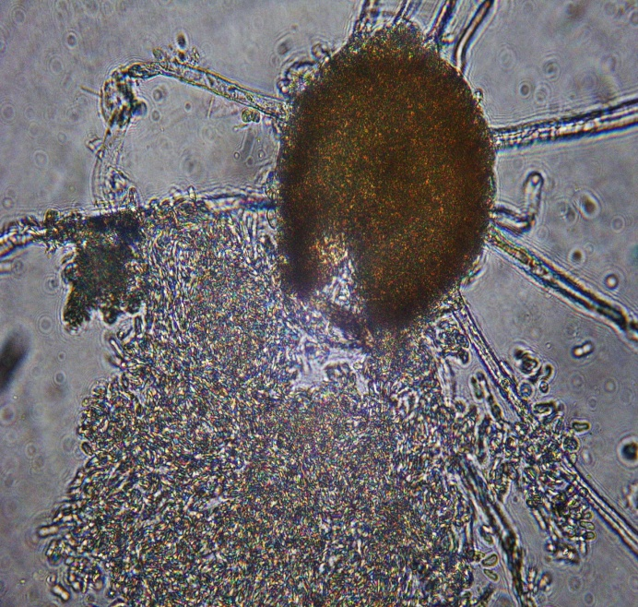
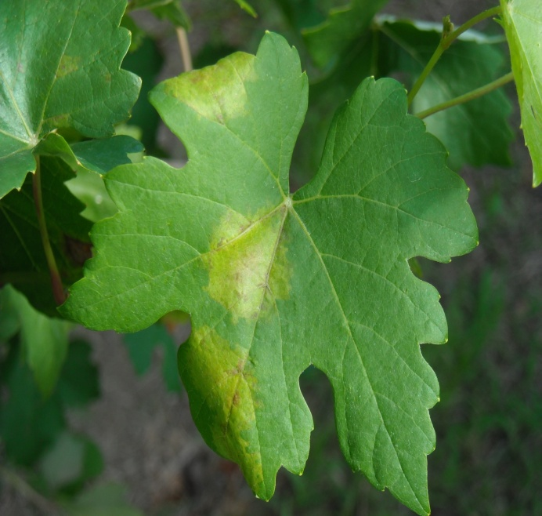
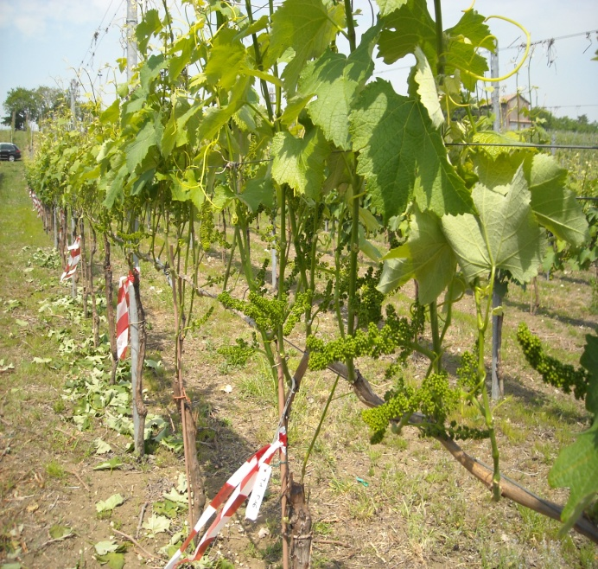
The innovative cropping systems
based on:
Plant resistance
Biocontrol agents
Disease models
Canopy management

Slide 5
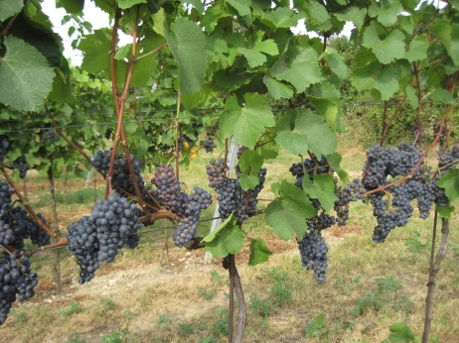
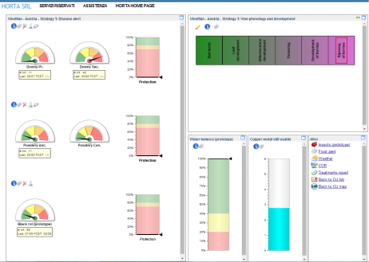
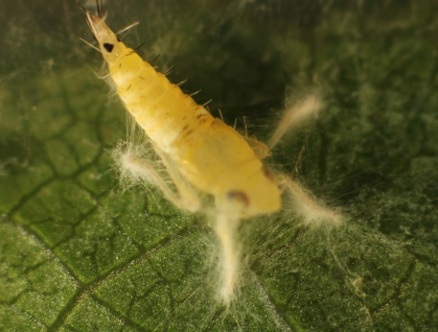
Recommendations to end-users
  Perform leaf removal at pre flowering stage on
  varieties with very compact clusters
  Use epidemiological models to better schedule
  treatments against downy and powdery mildew
  Do not mix the BCA Botector, Serenade and
  AQ10 with copper
  A possible bio control strategy for the larvae of
  Scaphoideus titanus could be the use of Mycotal

